Slide 1

Lexical polyfunctionality in discourse: A quantitative corpus-based approach
Daniel W. Hieber
University of Alberta Language Technology Lab (ALTLab)
danielhieber.com
Hieber, Daniel W. 2022. Lexical polyfunctionality in discourse: A quantitative corpus-based approach. Poster presented at the Linguistics Society of America (LSA) Annual Meeting, January 6.

Slide 2
Introduction
Motivating Question: How flexible are parts of speech across languages?
This Project: A quantitative, corpus-based investigation of lexical flexibility (a.k.a. polyfunctionality, polycategoriality, conversion, or zero-derivation) in English (Indo-European) and Nuuchahnulth (Wakashan).
Based on my dissertation research:
https://www.researchgate.net/publication/353597964_Lexical_polyfunctionality_in_discourse_A_quantitative_corpus-based_approach
polyfunctional lexical items are those which appear in more than one discourse function—reference, predication, or modification—with no overt coding for that function.

Slide 3
Example: Nuuchahnulth
Ref: watqšiƛ ʔaƛimt
watq‑ši(ƛ) ʔaƛa‑imt
swallow-MOM two-PAST
completely.swallowed two
‘He swallowed two of them […]’
Pred: wik̓aƛ haʔukšiƛ ʔaƛiičiƛ
wik‑ʼaƛ haʔuk‑ši(ƛ) ʔaƛa‑ʽi·čiƛ
not-FIN eat-MOM two-INCEP
didn’t ate became.two
‘He [Mink] didn’t eat them and [the crabs] became two.’
Mod: hiiɬtqyaap̓up ʔaƛa qʷayac̓iik
hiɬ‑tqya·p̓i‑up ʔaƛa qʷayac̓iːk
there-back-MOM.CAUS two wolf
put.on.the.back two wolf
‘Two wolves put [the dead wolf] on their back.’

Slide 4
Previous Research
Croft (1984): Russian roots are least marked when their semantic category aligns with their discourse function.
Cannon (1985): 3.2% of English words were created via conversion.
Evans & Osada (2005): Mundari
small sample: 72% of stems can be used as either noun or verb.
large sample: 52% of stems can be used as either noun or verb.
Mithun (2017): 12% of Central Alaskan Yup’ik roots can be used as either noun or verb.

Slide 5
Data
English (Indo-European)
Variously described as highly flexible with fluid category membership (Crystal 1967: 47–48; Vonen 1994; Croft 2000: 75–76; 2001: 69; Farrell 2001; Cannon 1985) and fairly rigid with clearly-delineated categories (Rijkhoff 2007: 710; Schachter & Shopen 2007: 4, 11, 12; Velupillai 2012: 122, 126).
Source: Spoken portion of the Open American National Corpus (OANC), ~3.2 million tokens.
Nuuchahnulth (Wakashan)
One of the most discussed languages in the literature on lexical flexibility (Swadesh 1939b; Jacobsen 1979; Braithwaite 2015).
Source: Corpus collected by Toshihide Nakayama in Little (2003) and Louie (2003), ~8,300 tokens.

Slide 6
Methods: Annotation
Annotated each lexical item for its discourse function (reference / predication / modification).
Only zero-marked forms were included (no overt derivation).
Nuuchahnulth: Annotated the entirety of the corpus. (~8,300 tokens)
English: Annotated 100 lexical items randomly selected from each of 100 frequency bins, throughout the entire corpus. (~380,000 tokens)

Slide 7
Methods: Measuring Lexical Flexibility I
Rated each lexical item for its flexibility on a scale of 0 (rigid) to 1 (flexible).
Used a normalized Shannon’s H (Shannon 1948; 1951), an entropy / diversity measure used in ecology to measure species diversity (Avolio et al. 2012), and political science to measure attention diversity (Boydstun, Bevan & Thomas 2014).
In this study, Shannon’s H is a measure of the functional diversity of lexical items.

Slide 8
Methods: Measuring Lexical Flexibility II
Perfectly Rigid / Inflexible (H=0)
Perfectly Flexible (H=1)
lexeme | reference | predication | modification
stem | 100 | 100 | 100
lexeme | reference | predication | modification
stem | 300 | 0 | 0
uses are evenly distributed
functions are the most diverse
uses are unevenly distributed
no functional diversity

Slide 9
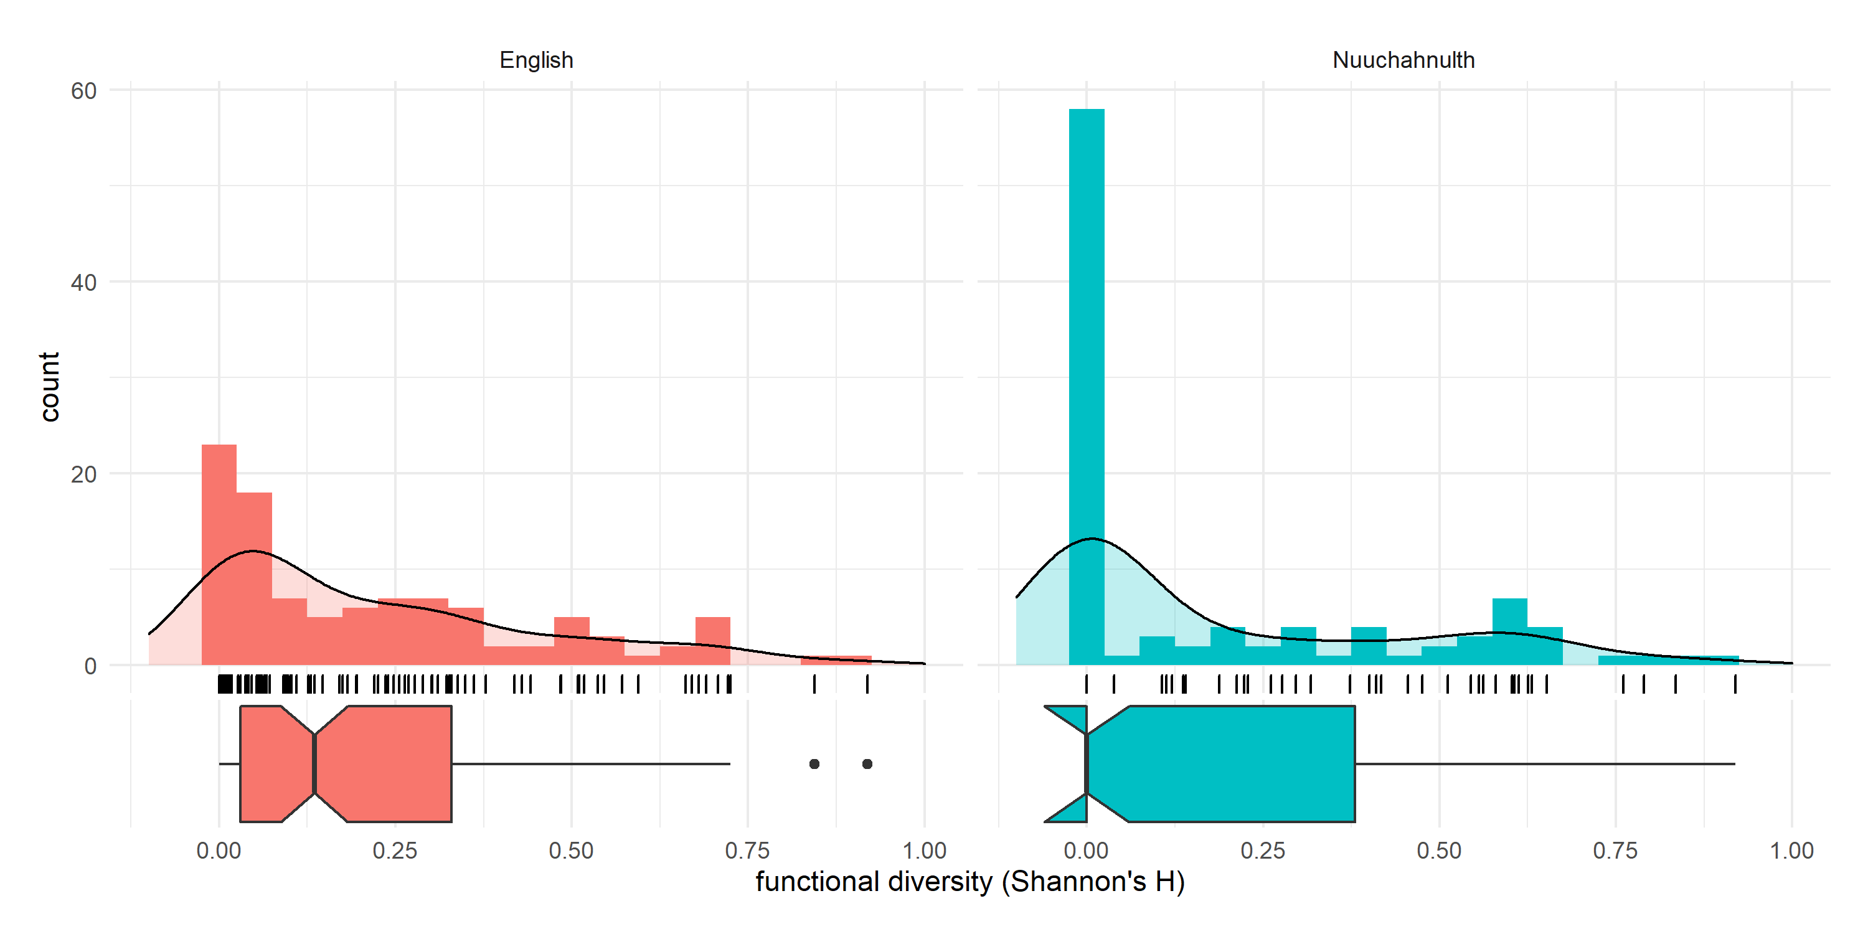
Results I: Functional Diversity Ratings
 | English | Nuuchahnulth
mean | 0.223 | 0.183
median | 0.134 | 0.000
standard deviation | 0.230 | 0.259

Slide 10
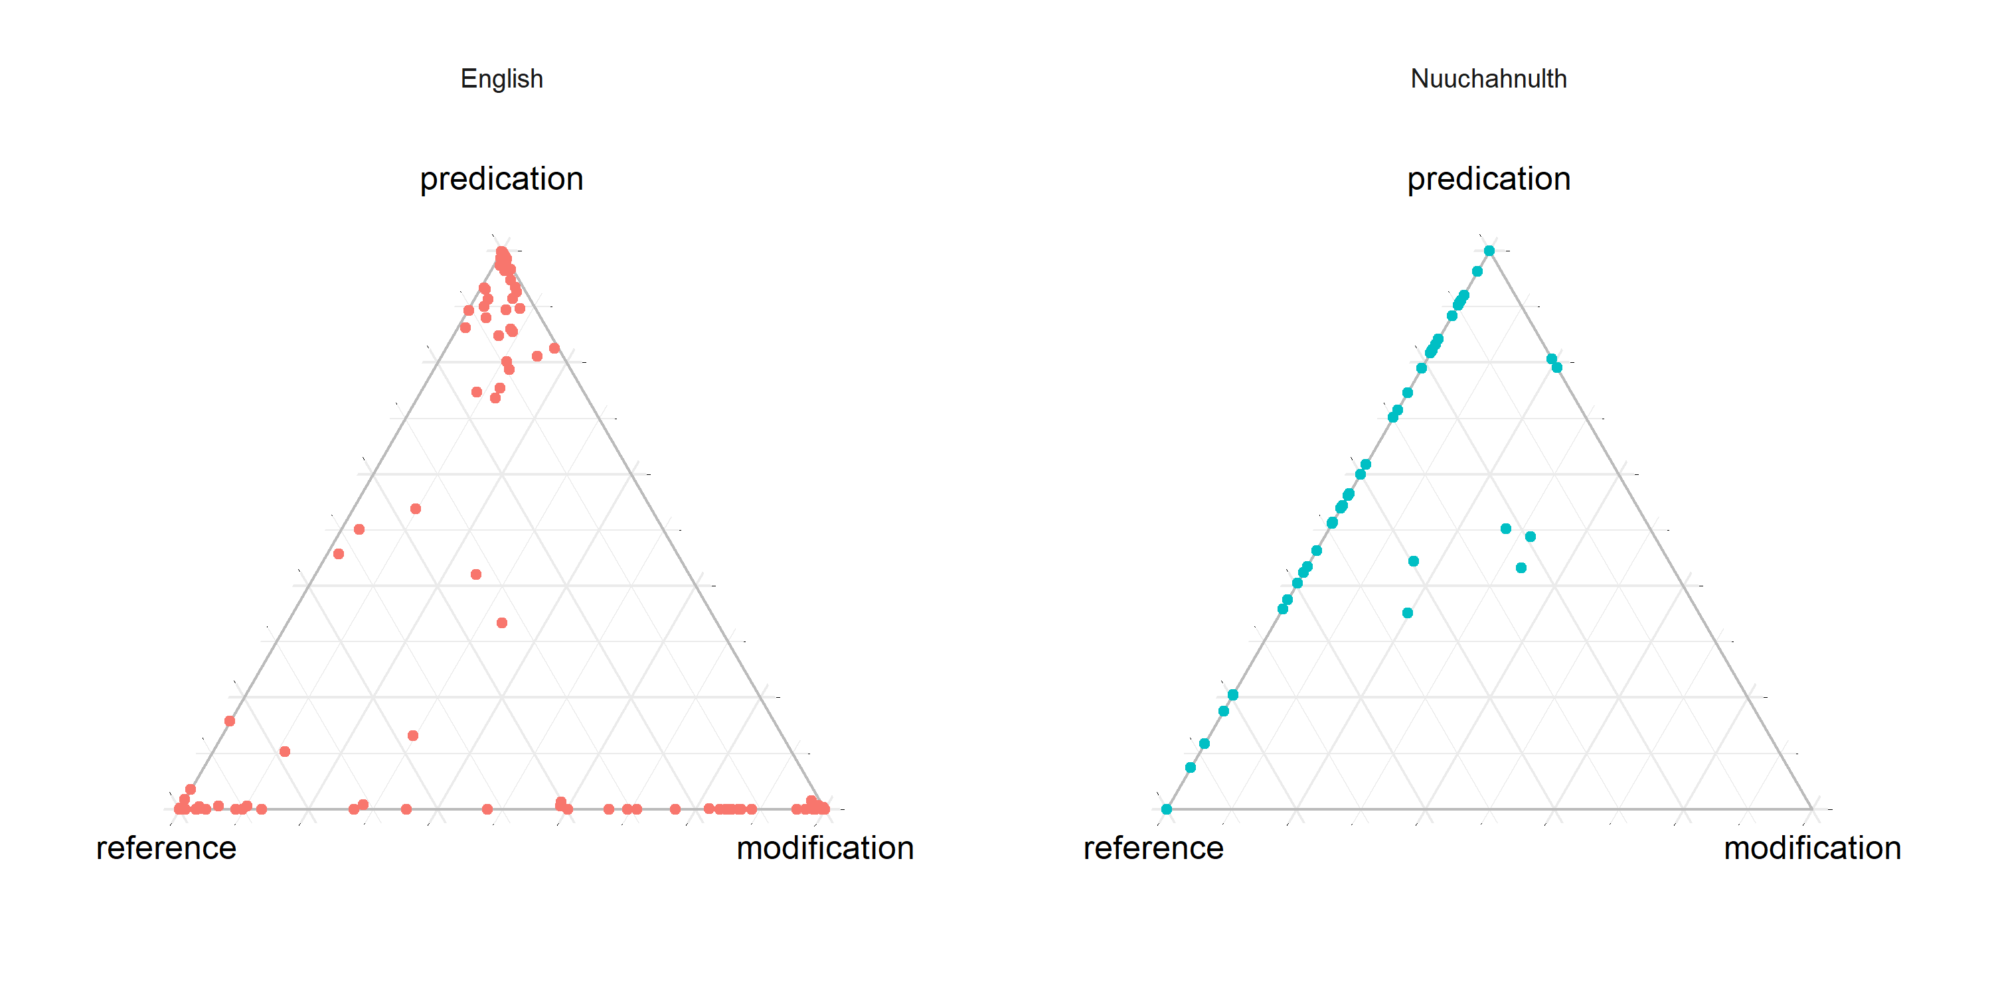
Results II: Distributions of Functions
Ternary plots represent the ratio of three variables as a point in an equilateral triangle.
Each point represents one lexical item.
The closer a lexical item is to a corner, the higher the ratio of its uses is for that function (reference, predication, or modification).

Slide 11
Results III: English
Lexical items tend to be strongly associated with a single discourse function.
However, all lexical items exhibit at least some flexibility.
Greatest degree of flexibility is between reference and modification.
These data present a more complicated picture of English than is usually claimed. It is neither wholly rigid nor wholly flexible.

Slide 12
Results III: Nuuchahnulth
Because of the smaller corpus size, most stems in Nuuchahnulth do not occur frequently enough to obtain a clear assessment of their functional diversity.
However, those stems that do occur frequently enough tend to have a high degree of polyfunctionality (~0.6).
Most Nuuchahnulth stems lie somewhere on the spectrum between reference and predication, with a relatively smooth cline of attested cases between the two.
Stems are infrequently used for modification, likely due to the lack of a dedicated morphological construction for modification.

Slide 13
Results IV: Semantic Patterns
A few preliminary observations of semantic patterns:
Human animates are consistently less functionally diverse in both languages. They are predominantly used for reference.
English: Quantifiers and property words have the lowest functional diversity.
Nuuchahnulth: Quantifiers and property words have the highest functional diversity.
This difference is likely connected to the lack of a dedicated morphological construction for modification in Nuuchahnulth.

Slide 14
Conclusions
This project models how to apply Shannon’s H to obtain a functional diversity measure for lexical items or morphemes.
Lexical flexibility is a matter of degree, and varies by lexical item.
Both English and Nuuchahnulth display a significant degree of lexical flexibility—Nuuchahnulth simply much more so than English.
Languages also differ in the way lexical flexibility is realized:
English: Each lexical item centers around a functional prototype.
Nuuchahnulth: High degree of lexical flexibility, but only along the reference-predication axis.
Previous impressions of English and Nuuchahnulth have been shown to be accurate, and are now be backed by empirical data:
English: Researchers see English lexical categories as fairly well-defined, but acknowledge many cases of functional shift.
Nuuchahnulth: Gives greater empirical support for Nakayama’s (2001: 50) claim that lexical categories in Nuuchahnulth are a statistical tendency.

Slide 15
References
Avolio, Meghan L., Jeremy M. Beaulieu, Eugenia Y. Y. Lo & Melinda D. Smith. 2012. Measuring genetic diversity in ecological studies. Plant Ecology 213(7). 1105–1115. doi:10.1007/s11258-012-0069-6.
Boydstun, Amber E., Shaun Bevan & Herschel F. Thomas. 2014. The importance of attention diversity and how to measure it. Policy Studies Journal 42(2). 173–196. doi:10.1111/psj.12055.
Cannon, Garland. 1985. Functional shift in English. Linguistics 23(3). 411–432. doi:10.1515/ling.1985.23.3.411.
Croft, William. 1984. Semantic and pragmatic correlates to syntactic categories. Chicago Linguistic Society 20. 53–71.
Croft, William. 2000. Parts of speech as typological universals and language particular categories. In Petra M. Vogel & Bernard Comrie (eds.), Approaches to the typology of word classes (Empirical Approaches to Language Typology 23), 65–102. Mouton de Gruyter. doi:10.1515/9783110806120.65.
Croft, William. 2001. Radical Construction Grammar: Syntactic theory in typological perspective. Oxford University Press. doi:10.1093/acprof:oso/9780198299554.001.0001.
Crystal, David. 1967. English. Lingua 17(3-4). 24–56. doi:10.1016/0024-3841(66)90003-9.
Farrell, Patrick. 2001. Functional shift as category underspecification. English Language & Linguistics 5(1). 109–130. doi:10.1017/S1360674301000156.
Little, Caroline. 2003. Caroline Little’s Nuu-chah-nulth (Ahousaht) texts with grammatical analysis. Toshihide Nakayama (ed.) (Endangered Languages of the Pacific Rim A2-27). Nakanishi Press.
Louie, George. 2003. George Louie’s Nuu-chah-nulth (Ahousaht) texts with grammatical analysis. Toshihide Nakayama (ed.) (Endangered Languages of the Pacific Rim A2-028). Nakanishi Press.
Mithun, Marianne. 2017. Polycategoriality and zero derivation: Insights from Central Alaskan Yup’ik Eskimo. In Valentina Vapnarsky & Edy Veneziano (eds.), Lexical polycategoriality: Cross-linguistic, cross-theoretical and language acquisition approaches (Studies in Language Companion Series 182), 155–176. John Benjamins. doi:10.1075/slcs.182.06mit.
Nakayama, Toshihide. 2001. Nuuchahnulth (Nootka) morphosyntax (University of California Publications in Linguistics 134). University of California Press.
Nicholas & Toshiki Osada. 2005. Mundari: The myth of a language without word classes. Linguistic Typology 9(3). 351–390. doi:10.1515/lity.2005.9.3.351.
Rijkhoff, Jan. 2007. Word classes. Language & Linguistics Compass 1(6). 709–726. doi:10.1111/j.1749-818x.2007.00030.xWord.
Schachter, Paul & Timothy Shopen. 2007. Parts-of-speech systems. In Timothy Shopen (ed.), Language typology and syntactic description, Vol. 1: Clause structure, 2nd edn., 1–60. Cambridge University Press. doi:10.1017/CBO9780511619427.001.
Shannon, Claude E. 1948. A mathematical theory of communication. The Bell System Technical Journal 27(3). 379–423. doi:10.1002/j.1538-7305.1948.tb01338.x.
Shannon, Claude E. 1951. Prediction and entropy of printed English. The Bell System Technical Journal 30(1). 50–64. doi:10.1002/j.1538-7305.1951.tb01366.x.
Velupillai, Viveka. 2012. An introduction to linguistic typology. John Benjamins. doi:10.1075/z.176.
Vonen, Arnfinn M. 1994. Multifunctionality and morphology in Tokelau and English. Nordic Journal of Linguistics 17(2). 155–178. doi:10.1017/S0332586500002997.

